Slide 1

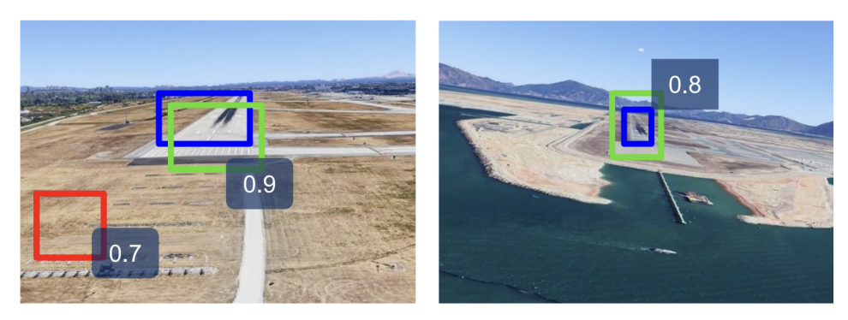

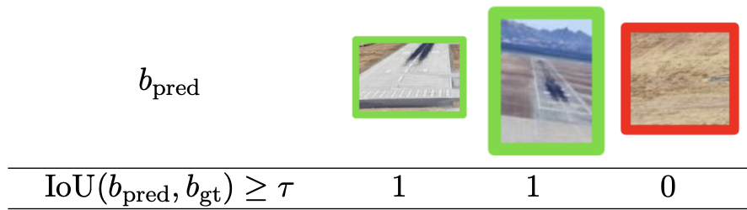
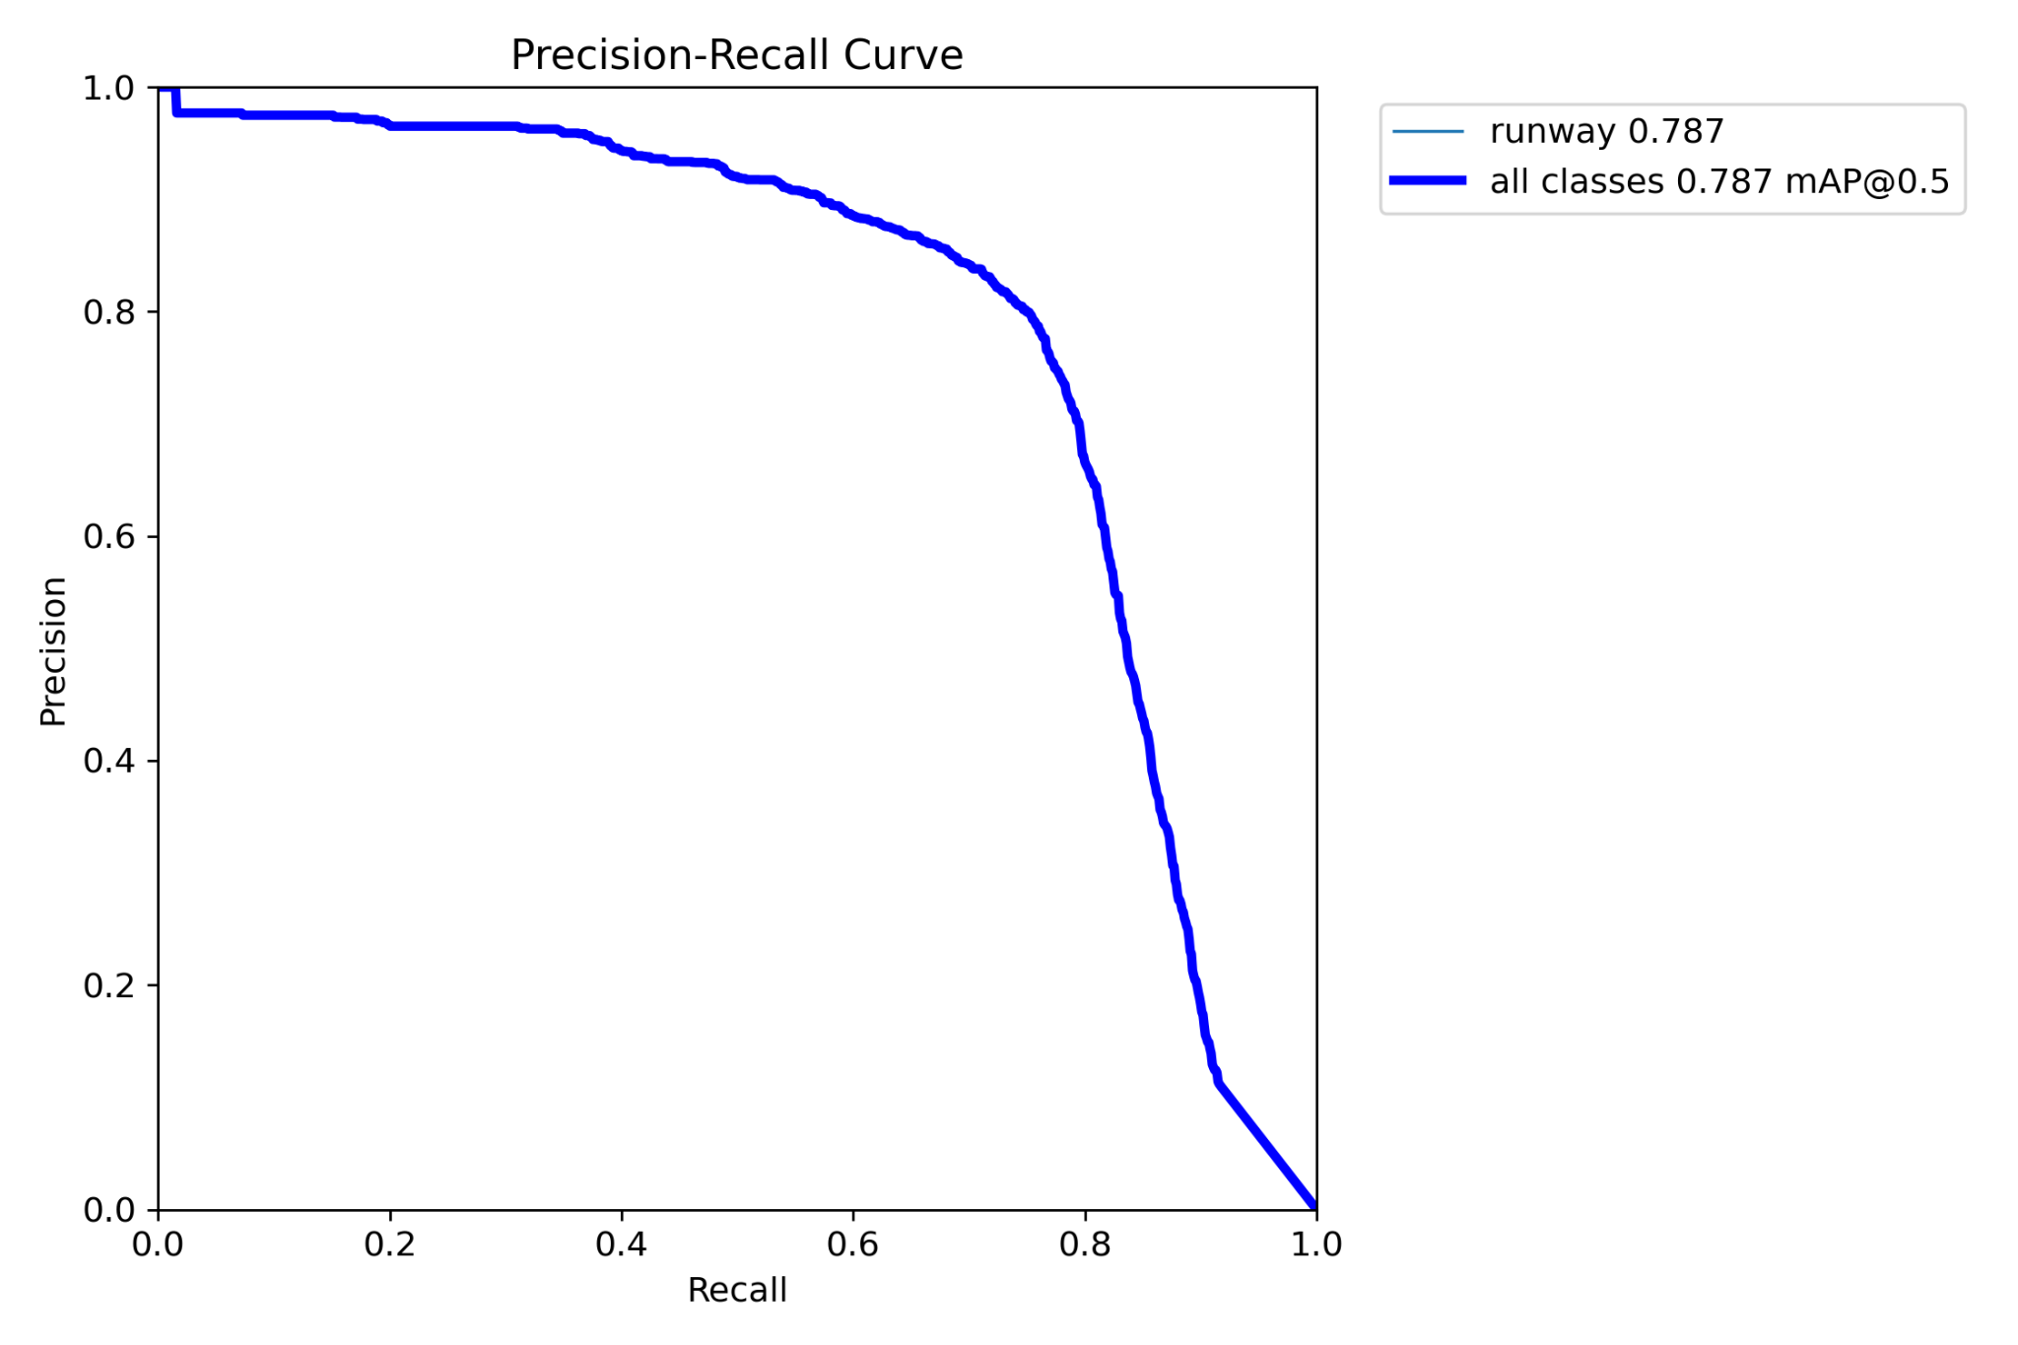
How’s AP computed ?
Let’s take a IoU Predefined threshold of 0.5 !
Computation of TP, FP, FN for Recall and Precision
1
True Positive
IoU = 0.96
3
Ranking Predicted Boxes by confidence score & match GT & Predictions based on maximisation of IoU.
2
False Positive
IoU = 0.22
4
Construct interpolated precision-recall curve
AP there !
False Negative
IoU = 0.00
Notes:
First, we choose an Intersection over Union (IoU) threshold — typically something like 0.5. Any predicted bounding box with an IoU above this threshold is considered a correct detection (true positive), while anything below it is considered incorrect (false positive).
Next, we rank all predicted boxes by their confidence scores and compute the IoU between each predicted box and the corresponding ground truth boxes.
To calculate the Average Precision (AP) for a specific class, we evaluate the model’s precision and recall at various confidence thresholds. The IoU helps us determine whether each prediction is a true positive or a false positive. Based on these, we compute true positives (TP), false positives (FP), and the total number of ground truth instances (for recall).
After calculating precision and recall across all predictions for a class, we plot a Precision-Recall (PR) curve. The area under this curve gives us the Average Precision (AP) for that class.
However, since the precision-recall data points are discrete, we use interpolation to smooth the curve and calculate a more accurate area under it. Finally, we average the APs across all classes to obtain the mean Average Precision (mAP) — a single metric that summarizes overall detection performance.

Slide 2
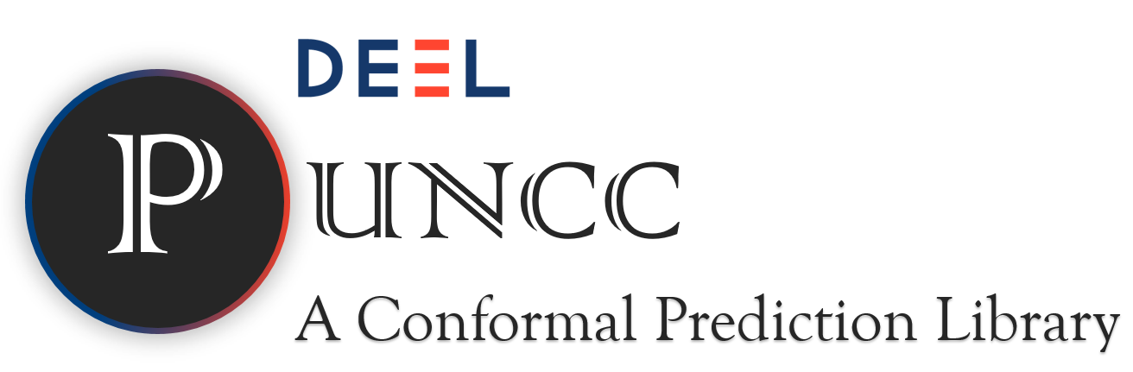

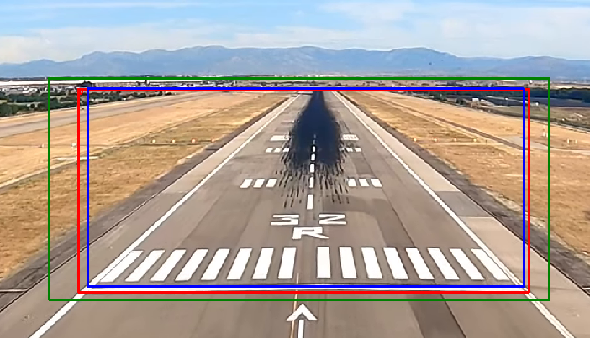
Goal: Safety Evaluation
GOAL = Predict bounding box that covers the true object under a certain level of risk
The problem …
2. 2D Key points extractions
1. Runway Detection
Crop
If the bounding box does not fully contain the ground truth and thus misses at least 3 key points ⇒ the VLS fails.
🚨
But HOW ? by applying Conformal Prediction to the output of object detection models.
⇒ We need to evaluate how conformalization affects performance using dedicated, industrially relevant metrics.
Conformal Box
Ground truth
YOLO Prediction
De Grancey et al, WAISE 2022
Notes:
So our goal here is to adapt the AI model responsible for the detection a posteriori so that the predicted bounded boxes cover the GT with statistical guarantees.
As you can see here, this is what we want, in blue cyan we have the BBox originally computed by the object detector, then in red the GT and finally in orange the conformalized box that will be an improvement of the blue one.
In order to achieve that, we’ll apply conformal prediction on the object detection model’s output using the PUNCC library.
And we need to evaluate how the conformalization affects performance using dedicated, industrially relevant metrics.

Slide 3

How does CP work for Object Detection ?
⇒ Test data i.i.d. with respect to calibration
Independence: each image does not depend on the others
Identical distribution: same distribution for test and calibration
HYPOTHESIS :
Key Steps in Conformal Object Detection with PUNCC :
Train a Base Predictor → YOLO
Consider a Calibration Set → independent from Training Set
Keep only true positive based on IoU
Compute 4 Nonconformity Scores
Expand the predicted bounded box.
Calibration Item
True Positive ?
(xmax , Ymax)
(xmin , Ymin)
Mendil et al, PLMR 2023
Notes:
Préciser utilisation de la librairie puncc

Slide 4
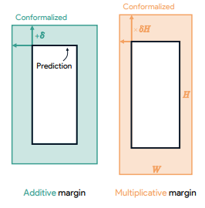
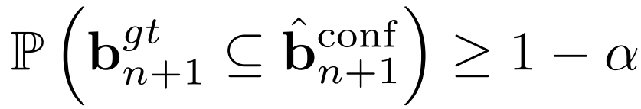
But how to expand a box ?
differences between predictions & GT - for each of the four coordinates of the bounding box (xmin, ymin, xmax, ymax).
For example, for additive nonconformity measure:
1. Computation of non-conformity scores
4 independent distributions … but is the risk actually respected ?
2. SOLUTION = stricter quantiles (Bonferroni Correction)
Great for similar size object
Great for differents size object
Left
Right
3. Coordinate adjustment
Andéol et al, COPA 2023
Notes:
La solution : Correction de Bonferroni
On veut garantir que toutes les coordonnées en même temps respectent le niveau de confiance global.
On applique donc Bonferroni :
au lieu d’utiliser un quantile au niveau 1−α1 - \alpha1−α,
on utilise un quantile plus strict : 1−α41 - \frac{\alpha}{4}1−4α​ pour chaque coordonnée.
Ainsi, la probabilité que les 4 coordonnées soient toutes correctement couvertes est au moins 1−α1 - \alpha1−α

Slide 5
Are IoU & IoA robust metrics for VLS ?
How to guarantee a robust detection ?
IoA = 1
&
IoU = 0.4
Interpolation Error (high resolution images) ⇒ BAD Pose Estimation !
with IoA = 1 !
Only ?
IoA = 1
&
IoU = 0.9
NO Interpolation Error ⇒ GOOD Pose Estimation !
also with a decent IoU …
Zouzou et al, COPA 2025
Notes:
So our goal here is to adapt the AI model responsible for the detection a posteriori so that the predicted bounded boxes cover the GT with statistical guarantees.
As you can see here, this is what we want, in blue cyan we have the BBox originally computed by the object detector, then in red the GT and finally in orange the conformalized box that will be an improvement of the blue one.
In order to achieve that, we’ll apply conformal prediction on the object detection model’s output using the PUNCC library.
And we need to evaluate how the conformalization affects performance using dedicated, industrially relevant metrics.

Slide 6
Are IoU & IoA robust metrics for VLS ?
Our conformal predictor (CP) only ensures one part of what we call a “Robust Detection” when the base predictor ensure the other.
How to guarantee a robust detection ?
IoA = 1
&
IoU = 0.4
with IoA = 1 !
 | IoU>𝒕 | IoA=1 | Robust ?
YOLO
C-YOLO | ? |  | ?
Only ?
IoA = 1
&
IoU = 0.9
also with a decent IoU …
⇒ we want to evaluate the CP in term of how much the IoA = 1 guarantee degrades the IoU > t guarantee.
Zouzou et al, COPA 2025
Notes:
So our goal here is to adapt the AI model responsible for the detection a posteriori so that the predicted bounded boxes cover the GT with statistical guarantees.
As you can see here, this is what we want, in blue cyan we have the BBox originally computed by the object detector, then in red the GT and finally in orange the conformalized box that will be an improvement of the blue one.
In order to achieve that, we’ll apply conformal prediction on the object detection model’s output using the PUNCC library.
And we need to evaluate how the conformalization affects performance using dedicated, industrially relevant metrics.

Slide 7
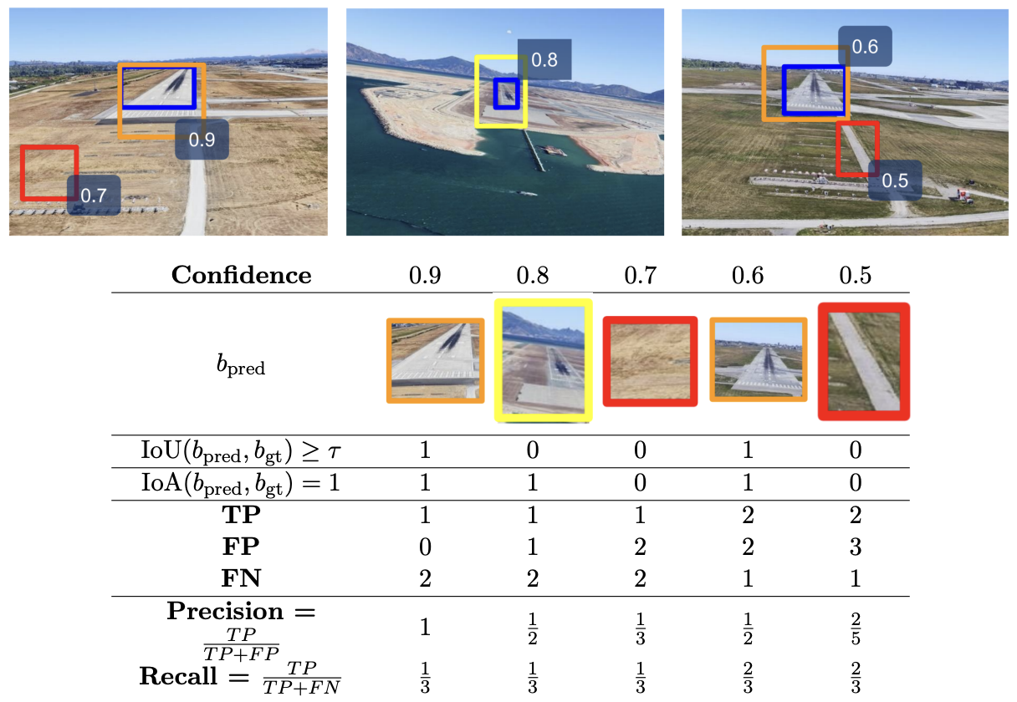
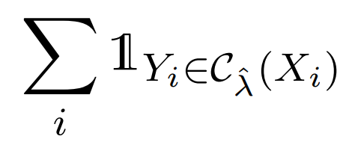



Evaluation : Coverage & C-mAP
COVERAGE (eg andeol
C-mAP
1 if the GT for an input is contained
within the conformal bounding box
0 if the GT ​ for an input is not contained
within the conformal bounding box
Coverage = 1
Coverage = 0
Zouzou et al, COPA 2025
Notes:
So our goal here is to adapt the AI model responsible for the detection a posteriori so that the predicted bounded boxes cover the GT with statistical guarantees.
As you can see here, this is what we want, in blue cyan we have the BBox originally computed by the object detector, then in red the GT and finally in orange the conformalized box that will be an improvement of the blue one.
In order to achieve that, we’ll apply conformal prediction on the object detection model’s output using the PUNCC library.
And we need to evaluate how the conformalization affects performance using dedicated, industrially relevant metrics.

